Slide 1
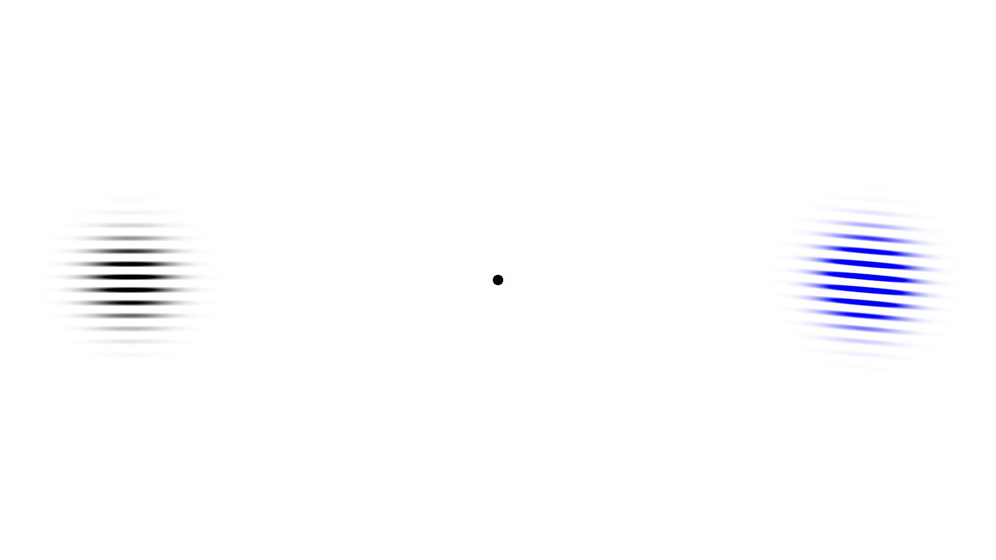
This task is designed to test your learning and memory.
On each trial, two sets of coloured lines will appear at the left and right sides of the screen. On each trial, one set of lines will be horizontal and one set will be angled. An example display is shown below:
Press the space bar for more instructions

Slide 2
Each trial requires a response of either UP or DOWN, which you will make using the arrow keys. Respond as fast as possible while maintaining a high level of accuracy.
The correct response is determined by the angle of the lines in one colour. For this reason the horizontal set of coloured lines is uninformative. Your task is to learn which colours are useful and which are not and which response (UP or DOWN) to issue for the different orientations.
To start, you will have to guess which response to make, but you will be given feedback on each trial. Pay attention to the feedback and try to learn which response to make according the angled lines. With some practice on the task, you will soon learn which colours are useful and start to make accurate responses to the angled lines.
Press the space bar for more instructions
Notes:
This seems an appropriate place to give an example, but I was unsure what to say as it depends on how much you want to tell people. You could say something like ‘for example, black (forward slanted) lines could mean the target is the stool and blue (backwards slanted) lines could be irrelevant. See the ‘summary of the task’ slide for how I summarised the predictors

Slide 3
At the start of each trial a small black circle will appear.
Make sure you focus on the small black circle until the two sets of coloured lines appear at the left and right sides of the screen.
Once the coloured lines appear you can move your eyes.
Make your response as quickly as possible on each trial, but try to avoid making errors. If you fail to respond within 3 seconds, or if you make an incorrect response, an error message will be displayed. When you make an error you will have to wait three seconds before the next trial starts. Try to avoid slow and inaccurate responses as it makes the task longer.
The experiment will take approximately 40 minutes. You will have a 30 second break every 80 trials and trials will start automatically after this break.
Press the space bar for more instructions

Slide 4
Summary of the task
Respond as quickly as possible while maintaining high accuracy.
Focus on the small black circle at the start of each trial. Move your eyes once the coloured lines appear.
One set of coloured lines on each trial is angled (informative) and the other set of coloured lines is horizontal (uninformative).
The angle of the lines in the informative colour tells you which response to make (UP or DOWN arrow keys).
After the first 40 trials we will display your accuracy and the experimenter will check if you have any further questions.
Contact the experimenter when you are ready to start

Slide 5
In the next phase of the experiment both sets of coloured lines will be angled. However, as before, on each trial only one set of coloured lines will be informative. The informative set of lines will continue to be presented in those colours that were angled previously.
Continue to pay attention to the colours that you have learnt are most useful in the task. Once the stimuli appear, move your eyes quickly towards these stimuli to identify which response to make.
Contact the experimenter when you are ready to start
Notes:
Changed ‘white circle’ to ‘grey circle’ and ‘white square’ to ‘grey square’ to make them visible with the white background. (Using ‘black circle’ instead of grey could lead to confusion with the small black circle used to focus attention in the center of the screen)
I also couldn’t remember whether you were doing the reversal cues in this experiment in the same way that you did in your pilot experiment. I changed the slide assuming the reversal cues would be the same. Used the next slide to give examples.

Slide 6
You may have noticed that before the two sets of coloured lines appeared, a grey circle appeared in the centre. This circle will now tell you that this is a “normal trial”, while a grey square will tell you this is a “reversed trial”.
The grey circle will now indicate a “normal trial”. For this type of trial, the same two colours you have learnt were useful previously will be useful for these trials.
The grey square will indicate a “reversed trial”. For this type of trial, the two colours that were previously uninformative will now be useful for determining which response to make. On reversed trials you should therefore pay attention to the coloured lines you have previously been ignoring.
Press the space bar for more instructions
Notes:
Changed ‘white circle’ to ‘grey circle’ and ‘white square’ to ‘grey square’ to make them visible with the white background. (Using ‘black circle’ instead of grey could lead to confusion with the small black circle used to focus attention in the center of the screen)
I also couldn’t remember whether you were doing the reversal cues in this experiment in the same way that you did in your pilot experiment. I changed the slide assuming the reversal cues would be the same. Used the next slide to give examples.

Slide 7
Summary of the task in the next phase
Respond as quickly as possible while maintaining high accuracy.
Focus on the small black circle at the start of each trial. Move your eyes once the coloured lines appear.
A grey circle indicates a normal trial: the colours you learnt were useful in the first phase will be useful on these trials.
A grey square indicates a reverse trial: the colours you were ignoring in the first phase will be useful on these trials.
Contact the experimenter when you are ready to start

Slide 8
INCORRECT

Slide 9
TIMEOUT – TOO SLOW

Slide 10
Rest break
Trials will start automatically in 30 seconds

Slide 11
The experiment is complete!
Thank you for taking part in this experiment. The task is designed to examine how instructions affect our visual attention system. In the task you first learnt to make eye movements towards two useful stimuli (two sets of coloured lines). We are interested in whether you are able to reverse this habit in the second phase of the experiment. We plan to look at your eye movements very closely to see whether they moved in the learnt direction or the instructed direction.
For more information, please contact the lead investigator Dr Tom Beesley (t.beesley@unsw.edu.au)
Thank you once again. Please see the experimenter.

